Slide 1
Railway Reservation System
Presenting By Aayush Chalke

Slide 2
OBJECT OF THE PROJECT
Online Ticket Booking
User Management
Train & Schedule Management
Passenger & Booking Management
Payment Handling
Reporting & Data Retrieval

Slide 3
Introduction
The Railway Reservation System is a database-driven project designed to facilitate train ticket booking, passenger management, and payment processing. This system helps railway authorities and passengers by automating the reservation process, reducing manual effort, and improving efficiency.
In traditional railway booking systems, passengers had to visit ticket counters physically, leading to long queues and delays. With digital transformation, this automated system provides an efficient way to handle train schedules, seat availability, bookings, and cancellations online.

Slide 4
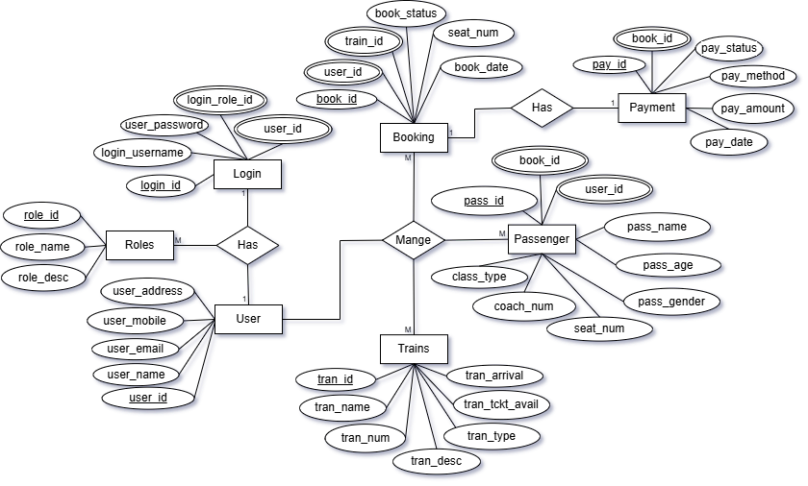
ENTITY RELATIONSHIP DIAGRAM

Slide 5
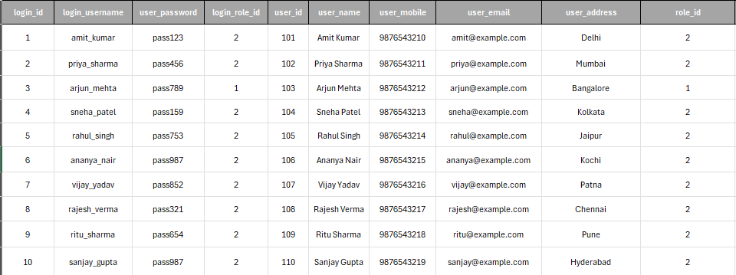
Raw Data Table

Slide 6
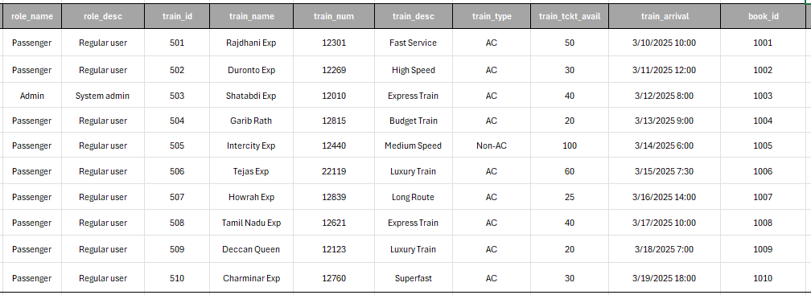
Raw Data Table

Slide 7
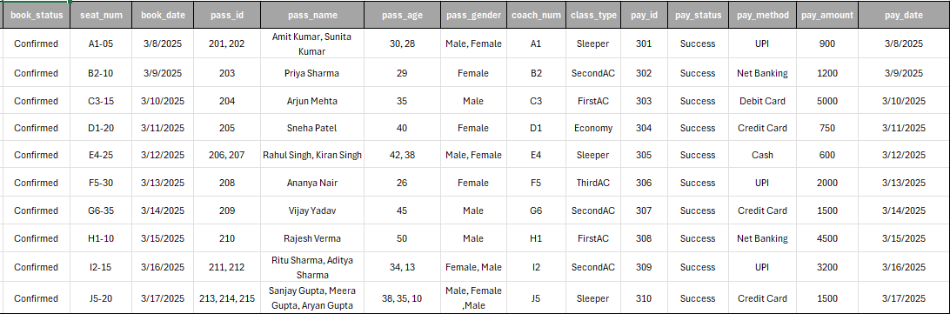
Raw Data Table

Slide 8
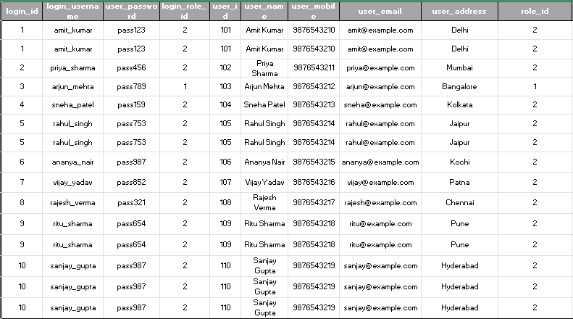
Performing Normalization: 1NF

Slide 9
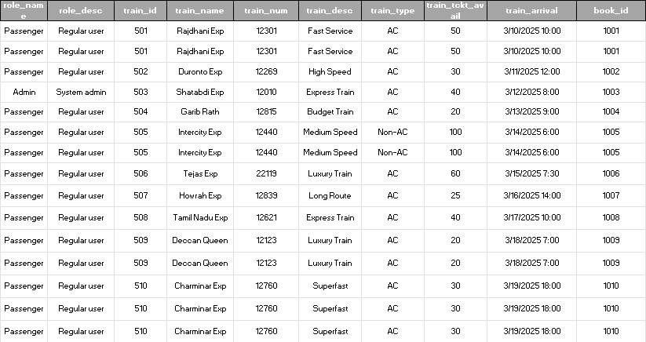
Performing Normalization: 1NF

Slide 10
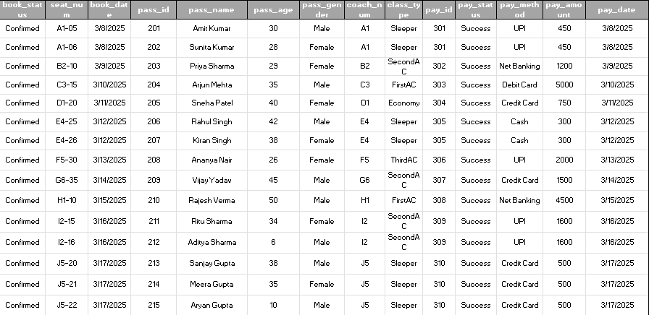
Performing Normalization: 1NF

Slide 11
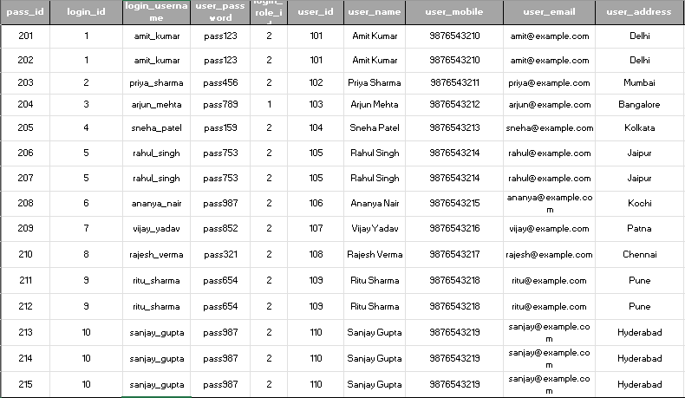
Performing Normalization: 2NF

Slide 12
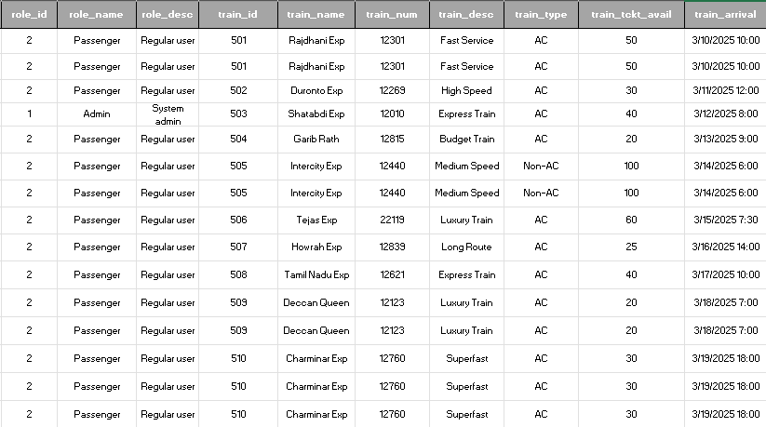
Performing Normalization: 2NF

Slide 13
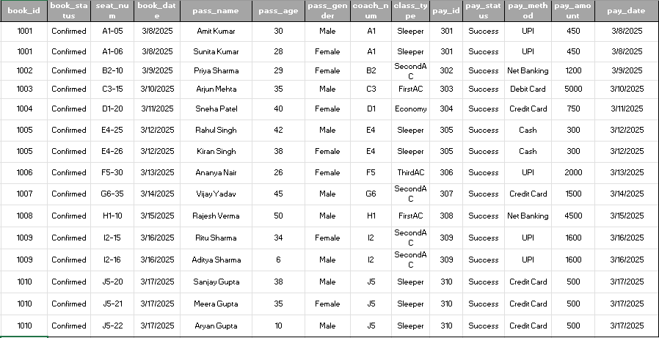
Performing Normalization: 2NF

Slide 14
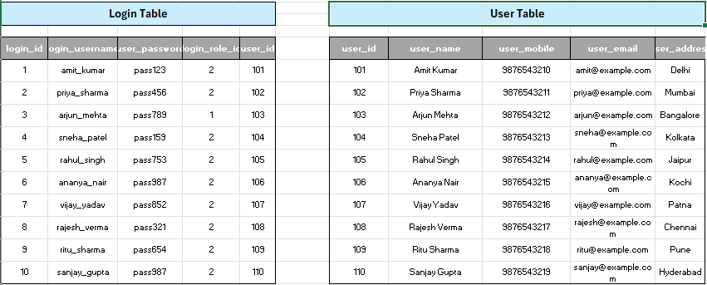
Performing Normalization: 3NF

Slide 15
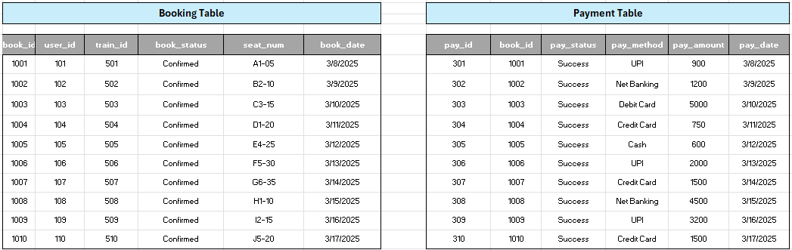
Performing Normalization: 3NF

Slide 16
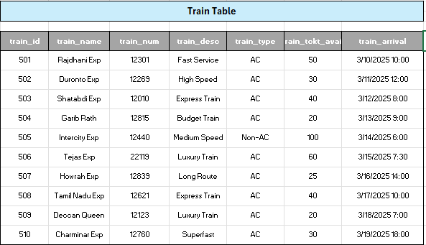
Performing Normalization: 3NF

Slide 17
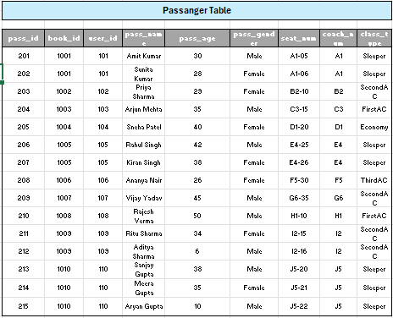
Performing Normalization: 3NF

Slide 18
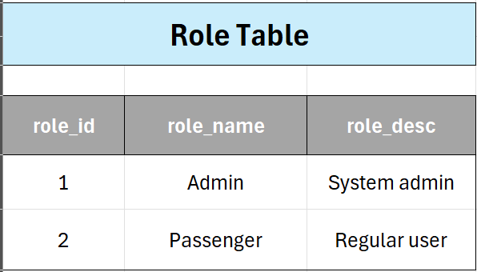
Performing Normalization: 3NF

Slide 19
Table In Project
01
02
03
04
05
06
User
Login
Role
Trains
Booking
Passenger
07
Payment

Slide 20
Description Of Tables

Slide 21
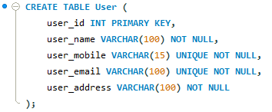
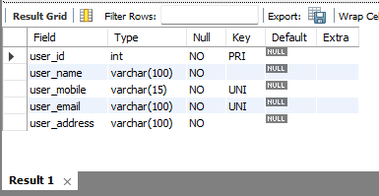
Table: User

Slide 22
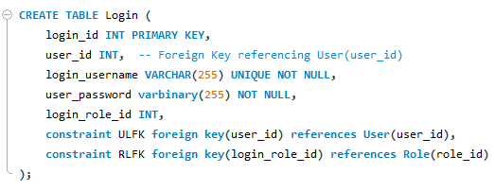
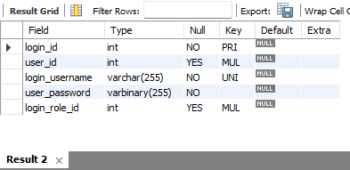
Table: Login

Slide 23
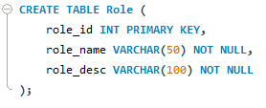
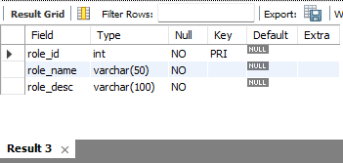
Table: Role

Slide 24
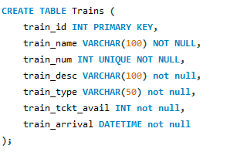
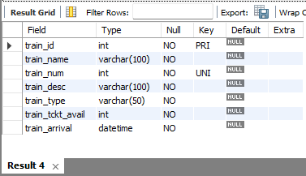
Table: Trains

Slide 25
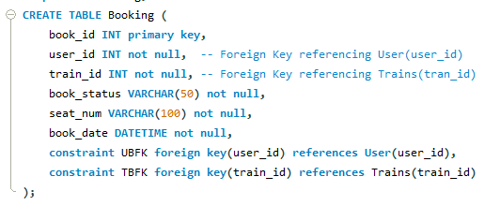
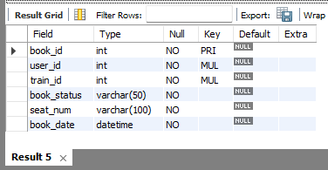
Table: Booking

Slide 26
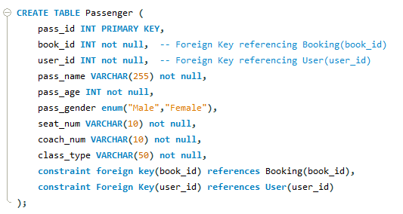
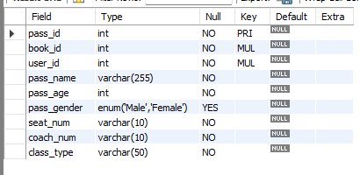
Table: Passenger

Slide 27
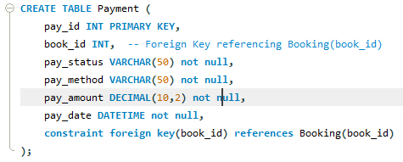
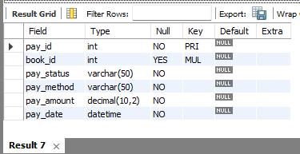
Table: Payment

Slide 28
INSERTING

Slide 29
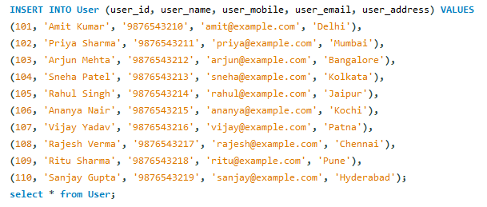
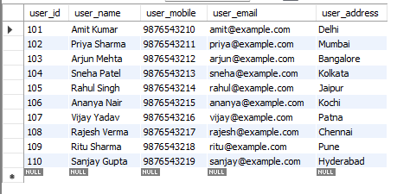
Insert in User

Slide 30
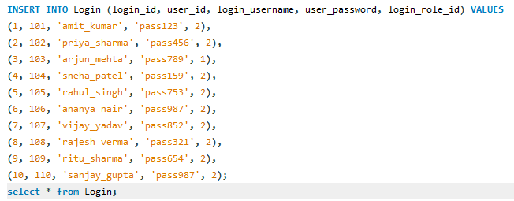
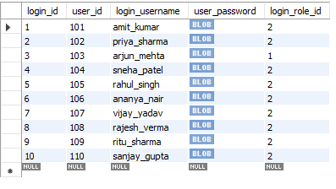
Insert in Login

Slide 31


Insert in Role

Slide 32
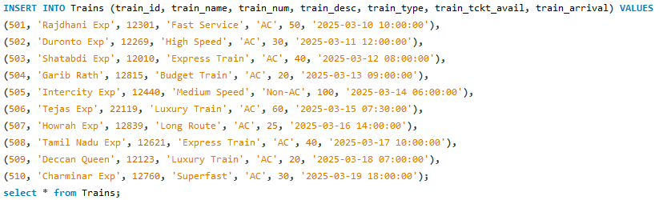
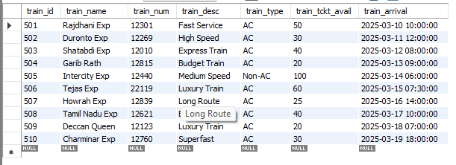
Insert in Trains

Slide 33
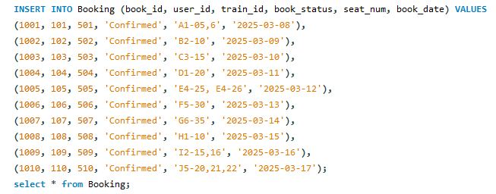
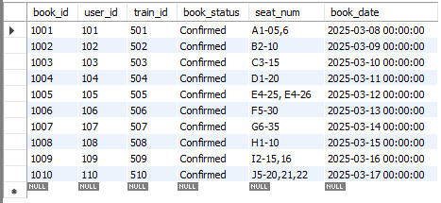
Insert in Booking

Slide 34
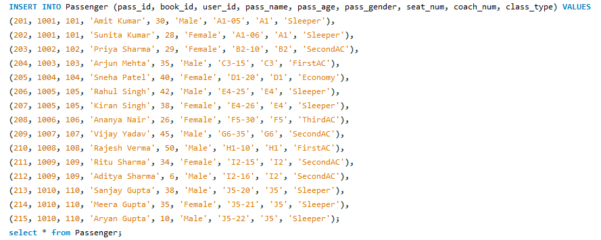
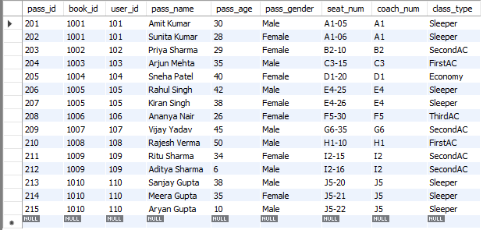
Insert in Passenger

Slide 35
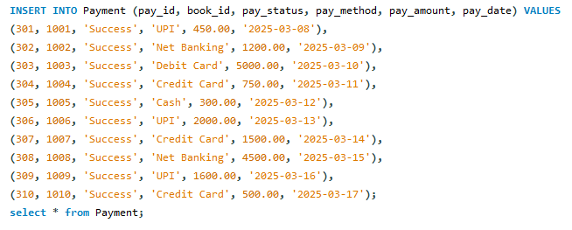
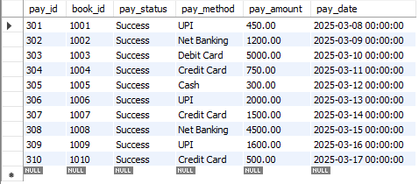
Insert in Payment

Slide 36
Performing DML Operations

Slide 37
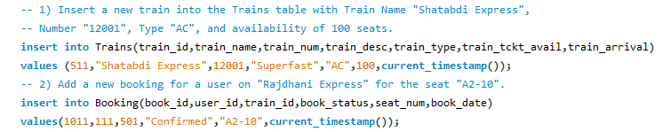
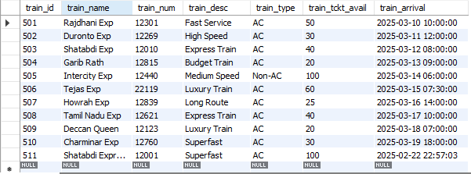
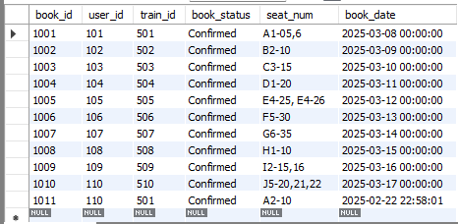
Insert Operation
In MySQL, the INSERT statement is used to add new rows of data to a table.

Slide 38
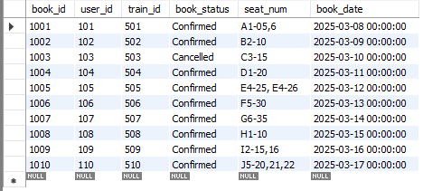
Update Operation
The UPDATE statement in MySQL is used to modify existing records in a table.

Slide 39

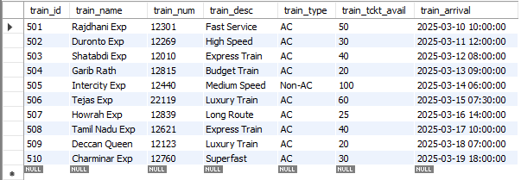
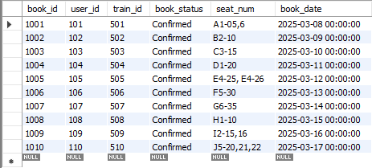
Delete Operation
In MySQL, DELETE is a statement used to remove rows from a table based on a specified condition.

Slide 40
Performing DDL Operations

Slide 41
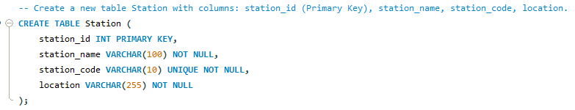
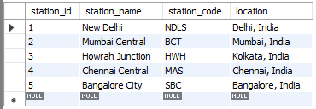
Create Operation
In MySQL, the CREATE statement is used to create a new database, table, index, or other objects.

Slide 42
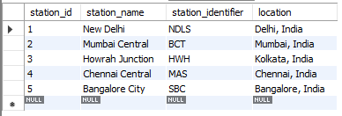
Rename Operation
In MySQL, the RENAME command in SQL is used to change the name of a table or a column.

Slide 43


Alter Operation
In MySQL, the ALTER statement is used to modify an existing database table.

Slide 44

Truncate Operation
In MySQL, TRUNCATE is a Data Definition Language (DDL) command used to quickly delete all rows from a table, resetting the auto-increment counter, if any.

Slide 45

Drop Operation
In MySQL, DROP is a SQL command used to delete a database, table, index, or other objects permanently.

Slide 46
Performing TCL Operations

Slide 47


Rollback Operation
In MySQL, the ROLLBACK is used to Undoes changes made in the current transaction before a COMMIT is issued.
For using the ROLLBACK and COMMIT in MySQL we need to fire this query “set @@autocommit = 0;”. Zero is used to off auto commit means auto save off and One is used to on the auto commit means auto save on.
To check the auto save we use this command “select @@autocommit;”.

Slide 48

Commit Operation
In MySQL, the COMMIT is used to Saves all changes made in the current transaction permanently.

Slide 49
Performing DQL Operations

Slide 50



Select Operation
In MySQL, the SELECT statement is used to retrieve data from one or more tables.

Slide 51


ORDER BY
The ORDER BY clause in SQL is used to sort the result set of a query in either ascending (ASC) or descending (DESC) order based on one or more columns. By default, the sorting order is ascending if not explicitly mentioned.

Slide 52

DISTINCT
Retrieve all unique train types from the Trains table.

Slide 53

LIMIT
In MySQL, LIMIT sets the limit that much return in the query

Slide 54
OPERATOR

Slide 55


Arithmetic Operators
1. Addition (+): Adds two values together.
2. Subtraction (-): Subtracts the second value from the first.

Slide 56


Arithmetic Operators
3. Multiplication (*): Multiplies two values.
4. Division (/): Divides the first value by the second.

Slide 57

Arithmetic Operators
5. Modulus (%): returns the remainder of a division operation

Slide 58


Comparison Operators
1. = (Equal to)
2. != or <> (Not equal to)

Slide 59


Comparison Operators
3. > (Greater than)
4. < (Less than)

Slide 60


Comparison Operators
5. >= (Greater than or equal to)
6. <= (Less than or equal to)

Slide 61


Logical Operators
1. AND (Both conditions must be true)
2. OR (At least one condition must be true)

Slide 62

Logical Operators
3. NOT (Negates a condition)

Slide 63


Pattern Matching Operators
1. LIKE (Pattern matching)
2. IN (Matches a list of values)

Slide 64
Pattern Matching Operators
3. BETWEEN (Selects values in a range)

Slide 65


Null Operators
1. IS NULL (Checks for NULL values)
2. IS NOT NULL (Checks for NOT NULL values)

Slide 66
BUILT-IN FUNCTION

Slide 67


String Function
1. Upper() Convert to Uppercase
2. Lower() Convert to Lowercase

Slide 68


String Function
3. Length() Find Length of a String
4. Concat() Concatenate Two Strings

Slide 69

String Function
5. Substring() Extract Part of a String

Slide 70


Agreegate Function
1. Count() Count Number of Records
2. Sum() Calculate Total Amount Paid

Slide 71


Agreegate Function
3. Avg() Find Average Ticket Price
4. Max() Find Maximum Ticket Price

Slide 72

Agreegate Function
5. Min() Find Minimum Ticket Price

Slide 73


Math Function
1. ABS() – Absolute Value
2. CEIL() – Round Up to the Nearest Integer

Slide 74


Math Function
3. FLOOR() – Round Down to the Nearest Integer
4. ROUND() – Round to a Specific Decimal Place

Slide 75


Math Function
5. POWER() – Exponential Calculation
6. SQRT() – Square Root Calculation

Slide 76

GROUP BY and HAVING
Find user that have booked more than 2 passengers.

Slide 77
SUBQUERY

Slide 78

A subquery is a nested query within another SQL query. Subqueries can be used in various clauses like SELECT, FROM, WHERE, etc., to perform advanced data retrieval and filtering.

Slide 79
JOIN

Slide 80

SQL joins are used to combine rows from two or more tables based on a related column.

Slide 81
VIEW

Slide 82

A view in SQL is a virtual table that provides a way to store a query for future use. It is not a physical table but rather a stored SQL query that can be treated like a table in SELECT statements.

Slide 83
Stored Procedure & Stored Function

Slide 84


Stored Procedure
A Stored Procedure is a precompiled collection of SQL statements and optional control-flow logic stored in a relational database.

Slide 85


Stored Function
A Stored Function in MySQL is a reusable SQL code block that performs a specific task and returns a single value.

Slide 86
CURSOR

Slide 87


In MySQL, a cursor is a database object that allows row-by-row processing of a result set.

Slide 88
TRIGGER

Slide 89


A trigger in MySQL is a database object that is automatically executed or fired when a specified event occurs on a table.

Slide 90
Thanks!
Do you have any questions?

